Slide 1
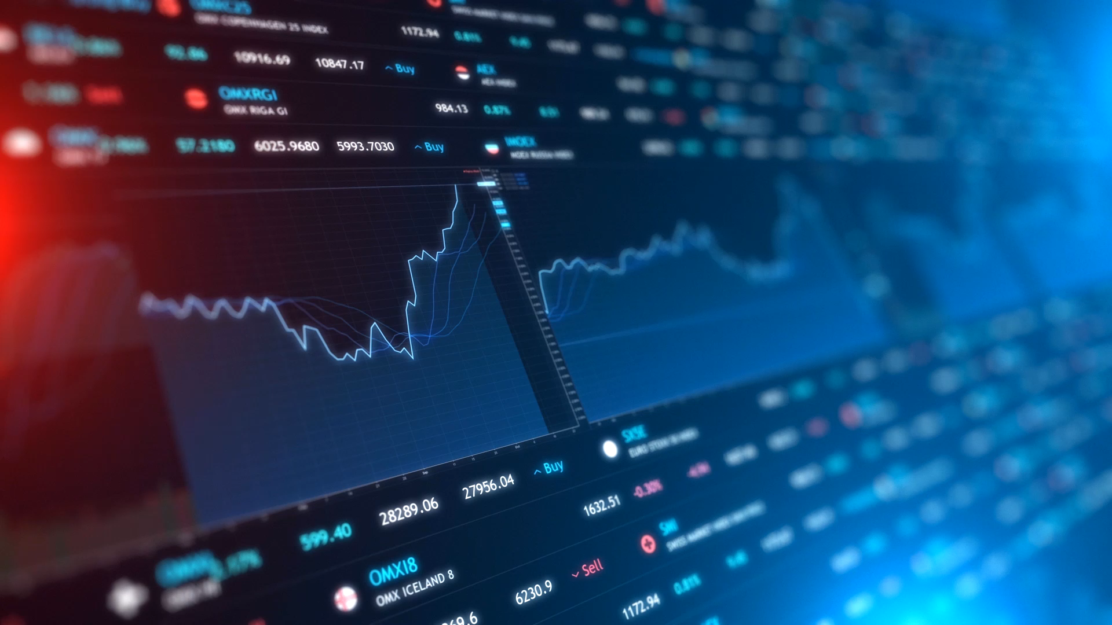
Social Network Effect and Stock Market Reaction
Group Members:
Leying (Dorothy) Zou 260950477
Khaled Al-Masaid 260623070
Fandi Yi 260722217
Beiqi Zhou 260742459

Slide 2


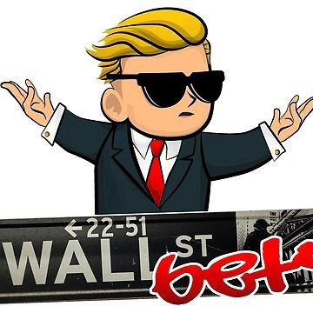
Social Media influence on stock market
Context - Social media had major effects on stock prices
We want to examine how social media could change the future of the stock market.
Methodologies to examine effect of social media on stock market
Social network analysis
Sentiment analysis
Stock prediction using deep neural network
Problem Statement
How can we use social media information to predict and better understand stock market return?
In fact, psychology is an important factor of the stock market reactions.
People nowadays, interact on social media, generates emotional data via tweets, forum posts, and blogs.
Example: United Airlines, Snapchat, WallStreetBets
Scientific studies show that people are often influence by the data they consume online and make decisions or take actions that aligned with it.
Notes:
Group 9
In 2017 United airlines forcibly removed a passenger from their flight and the video circulated on social media resulting in a public backlash against the company which resulted in stock price drop.
In February of 2018, celebrity Kylie Jenner tweeted that she no longer uses 'Snapchat' which is another social media platform. As a result of this tweet, Snpachat stock lost \$1.3 billion of its value.
Most recently, a subreddit called 'WallStreetBets' where participants discuss stocks and they became famous due to their influence on some stock such GameStop which had huge jumps.
In this project we decided to ….
Social network analysis – determine top influential accounts on twitter - Fandi
Sentiment analysis – find a statistical correlation between social media sentiment and stock price of a company - Dorothy
Predict stock prices through deep neural network – Beiqi
We will be focusing on GameStop stock for this project

Slide 3

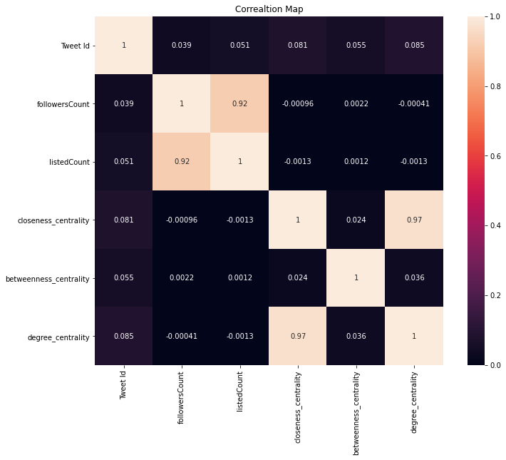
Data Source and Data Preprocessing
Data Source
GameStop Sentiment Dataset
GameStop Network Dataset
Scrap the data from Twitter using snscrape
From 2020-12-27 until 2021-02-26
With #gamestop hashtag
GME stock data from Yahoo: date, high, low, open, close, volume, adj close
Columns: Datetime, Tweet ID, Text, Username, user mention, followers Count, listed Count
Clean duplicate
Drop NaN
Clean the text: remove unnecessary URLs, remove replied messages, remove special characters (#, @)
Notes:
Display rows with a user mention other than NAN in order to perform our network analysis
1:45min

Slide 4
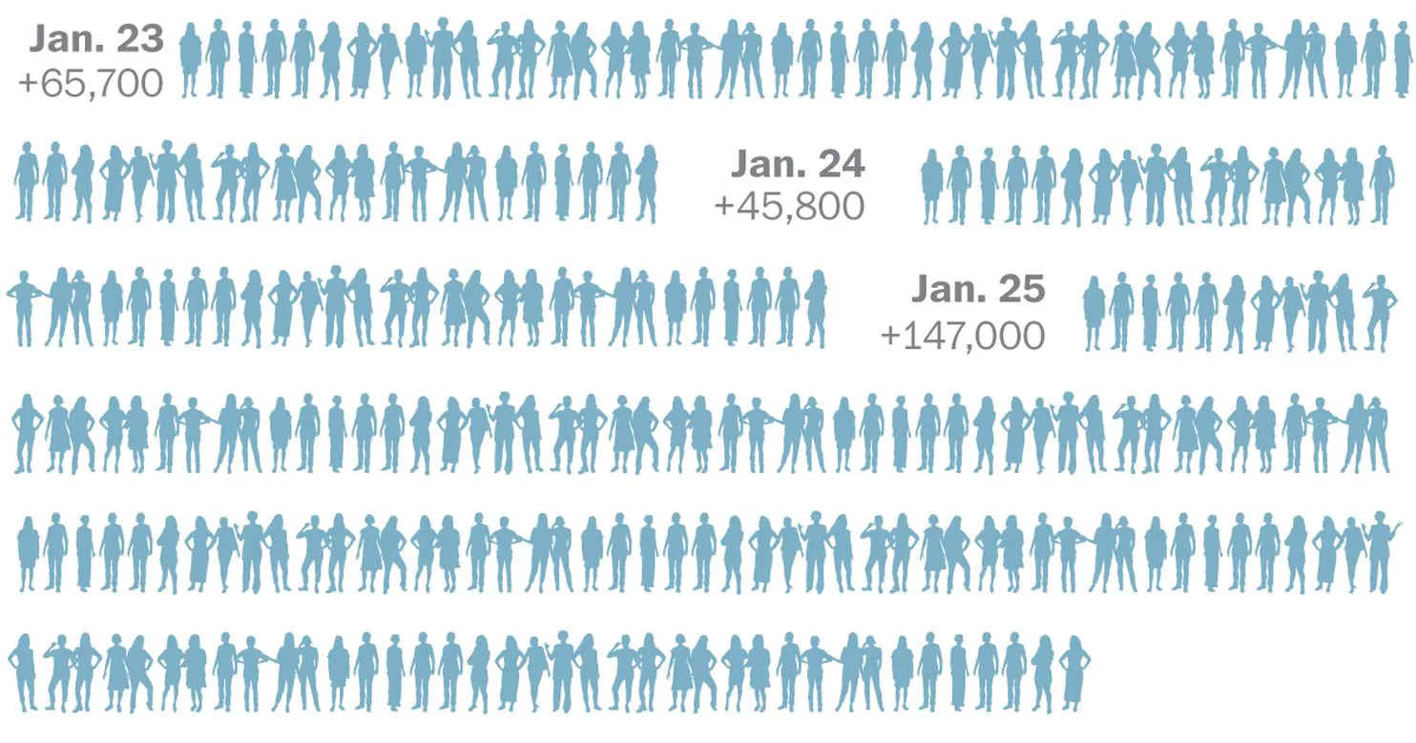
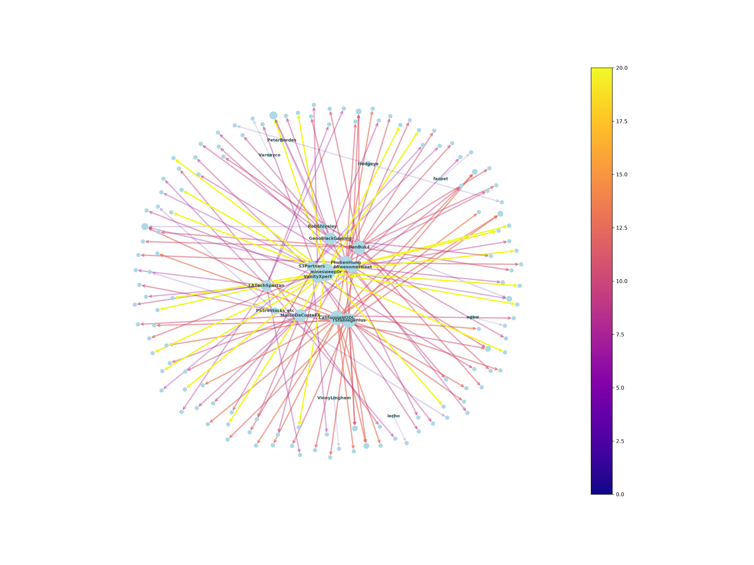
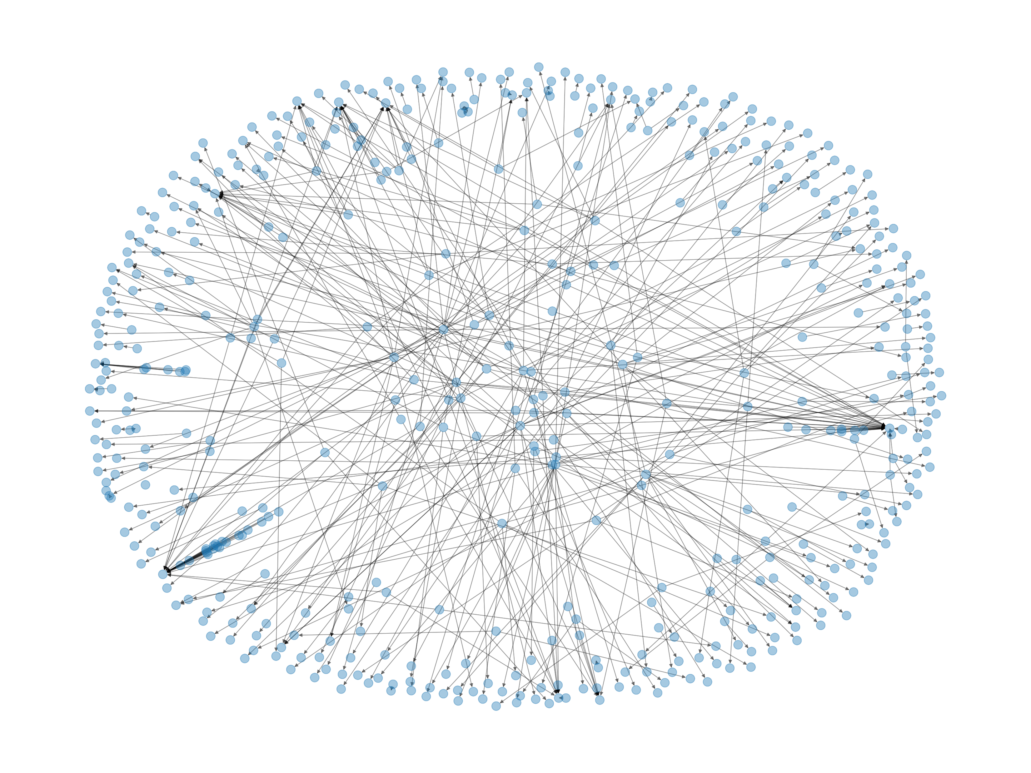
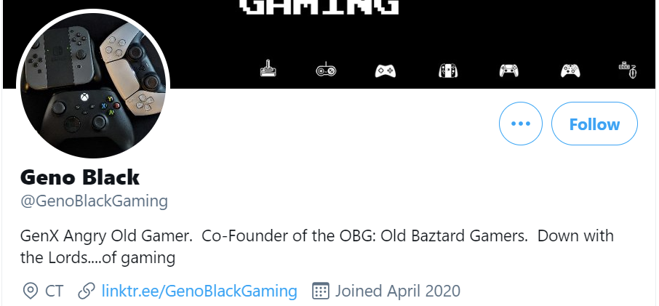
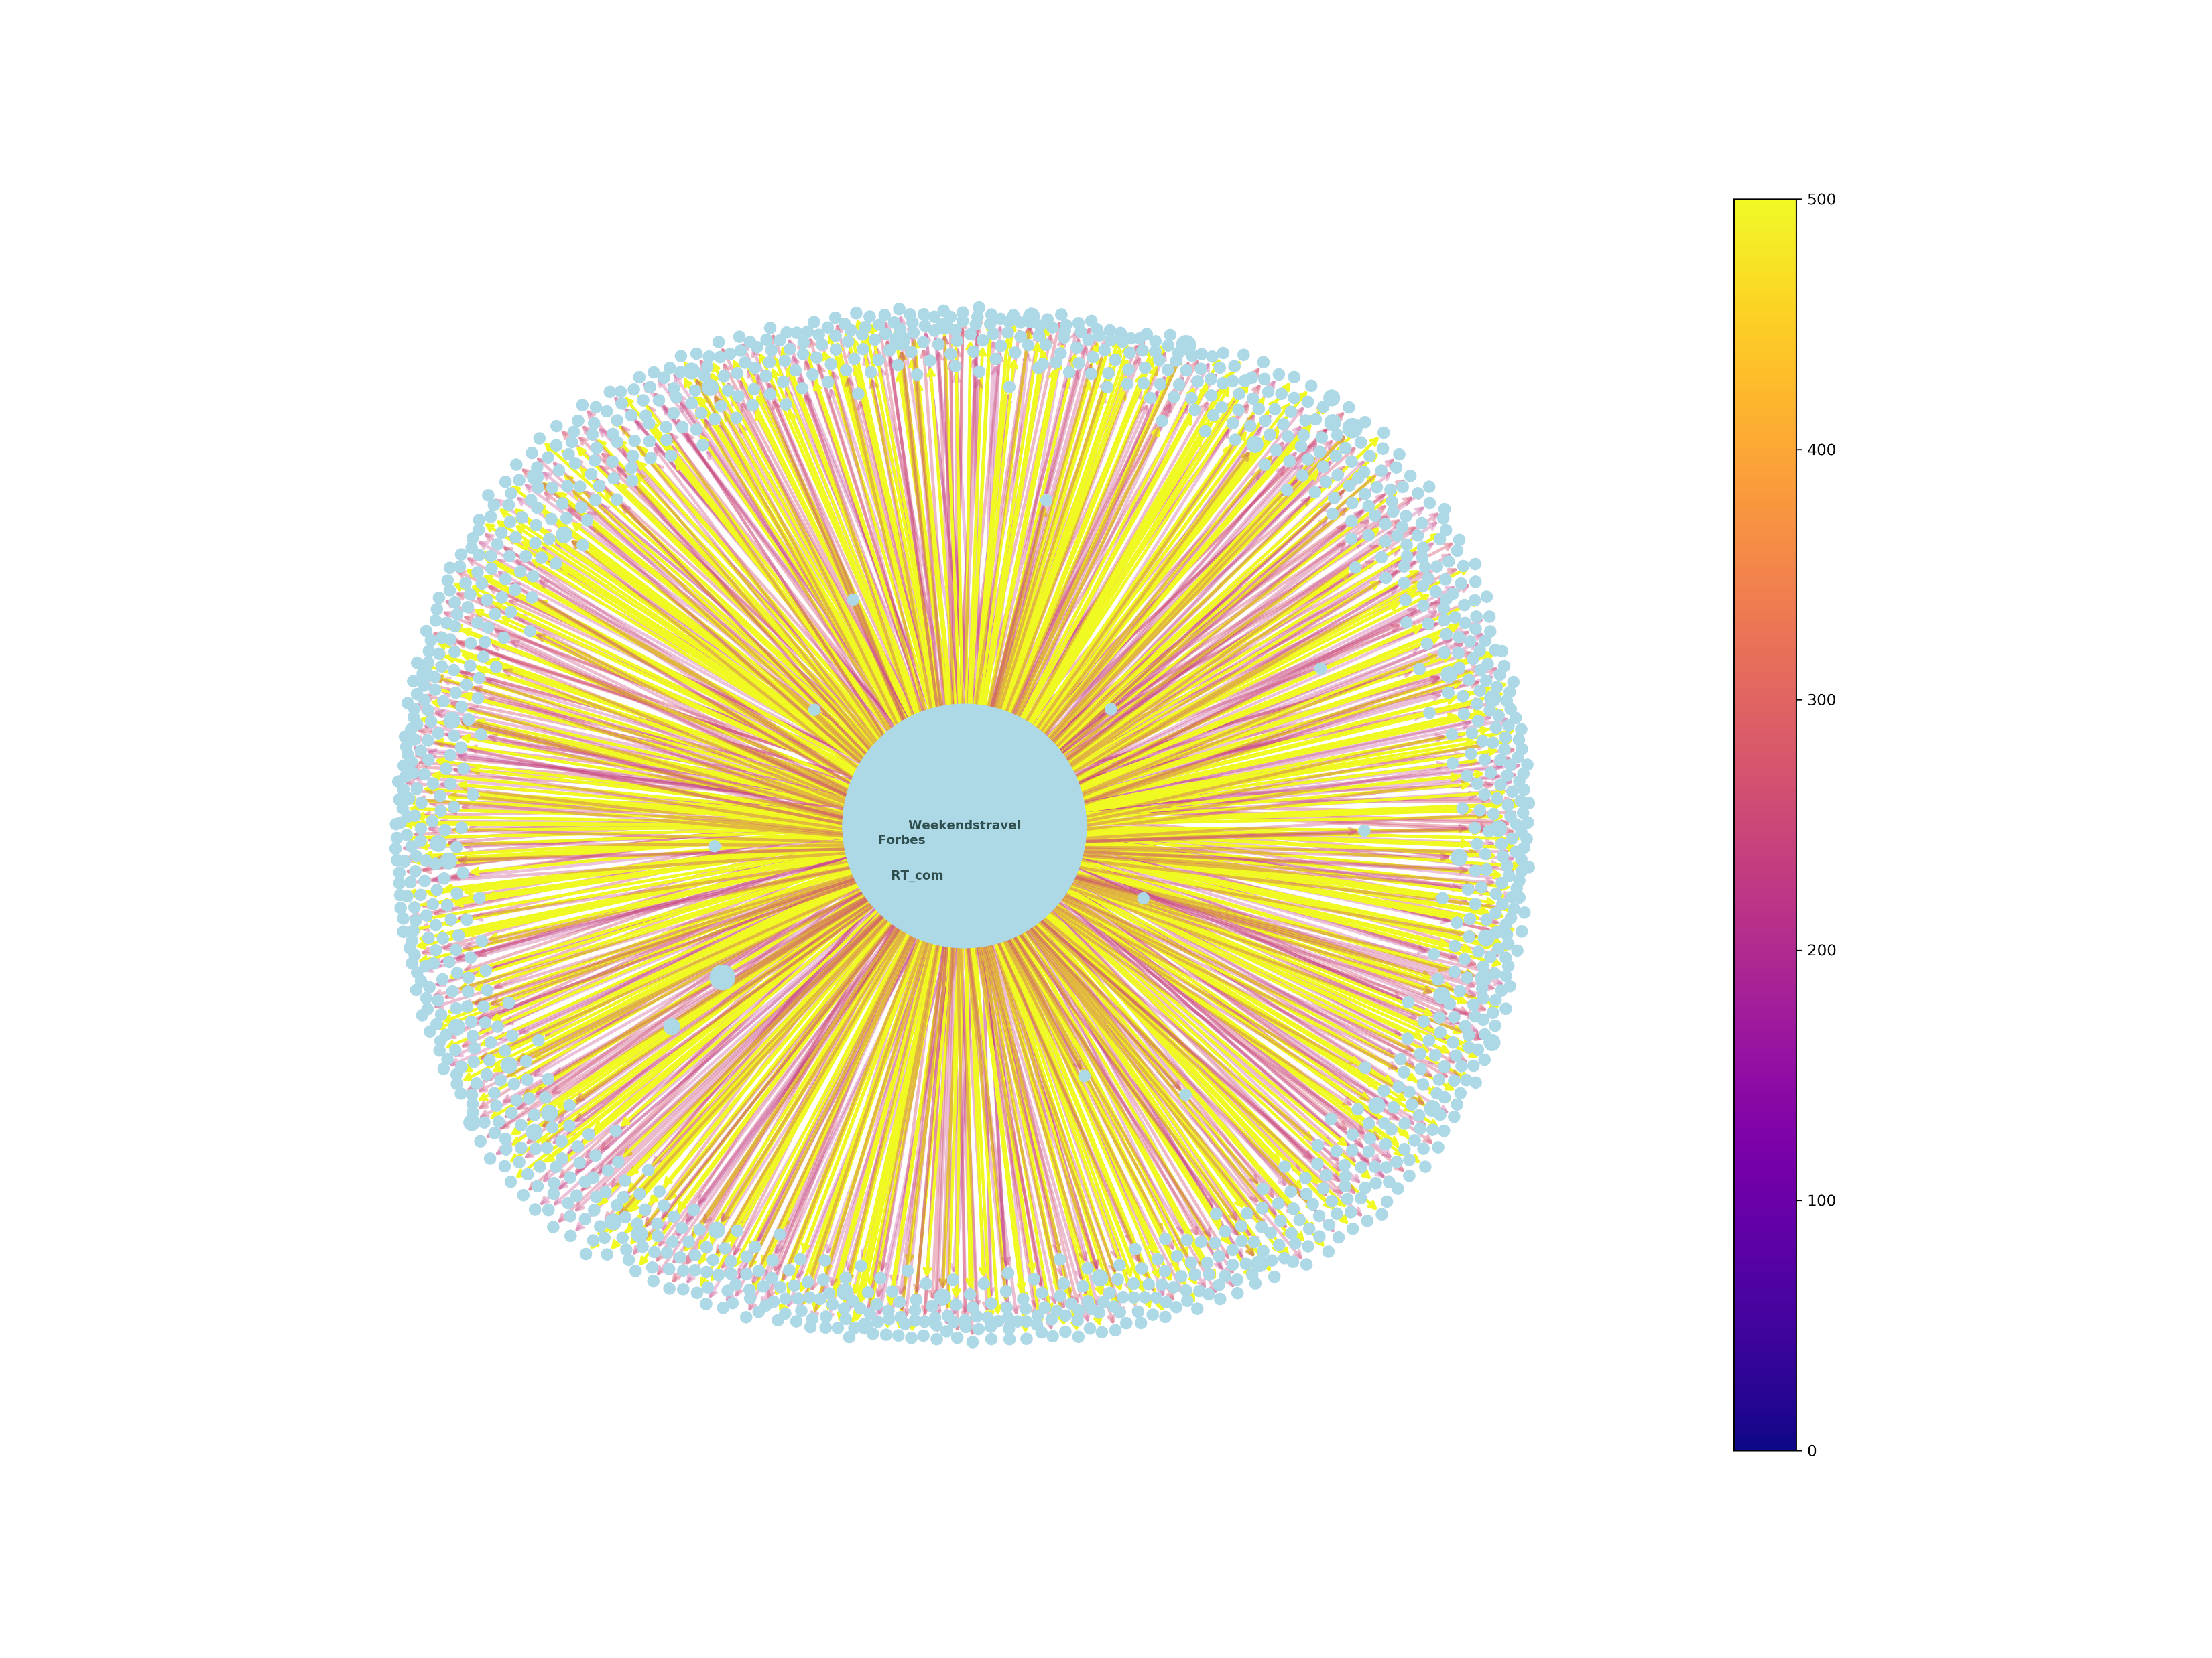
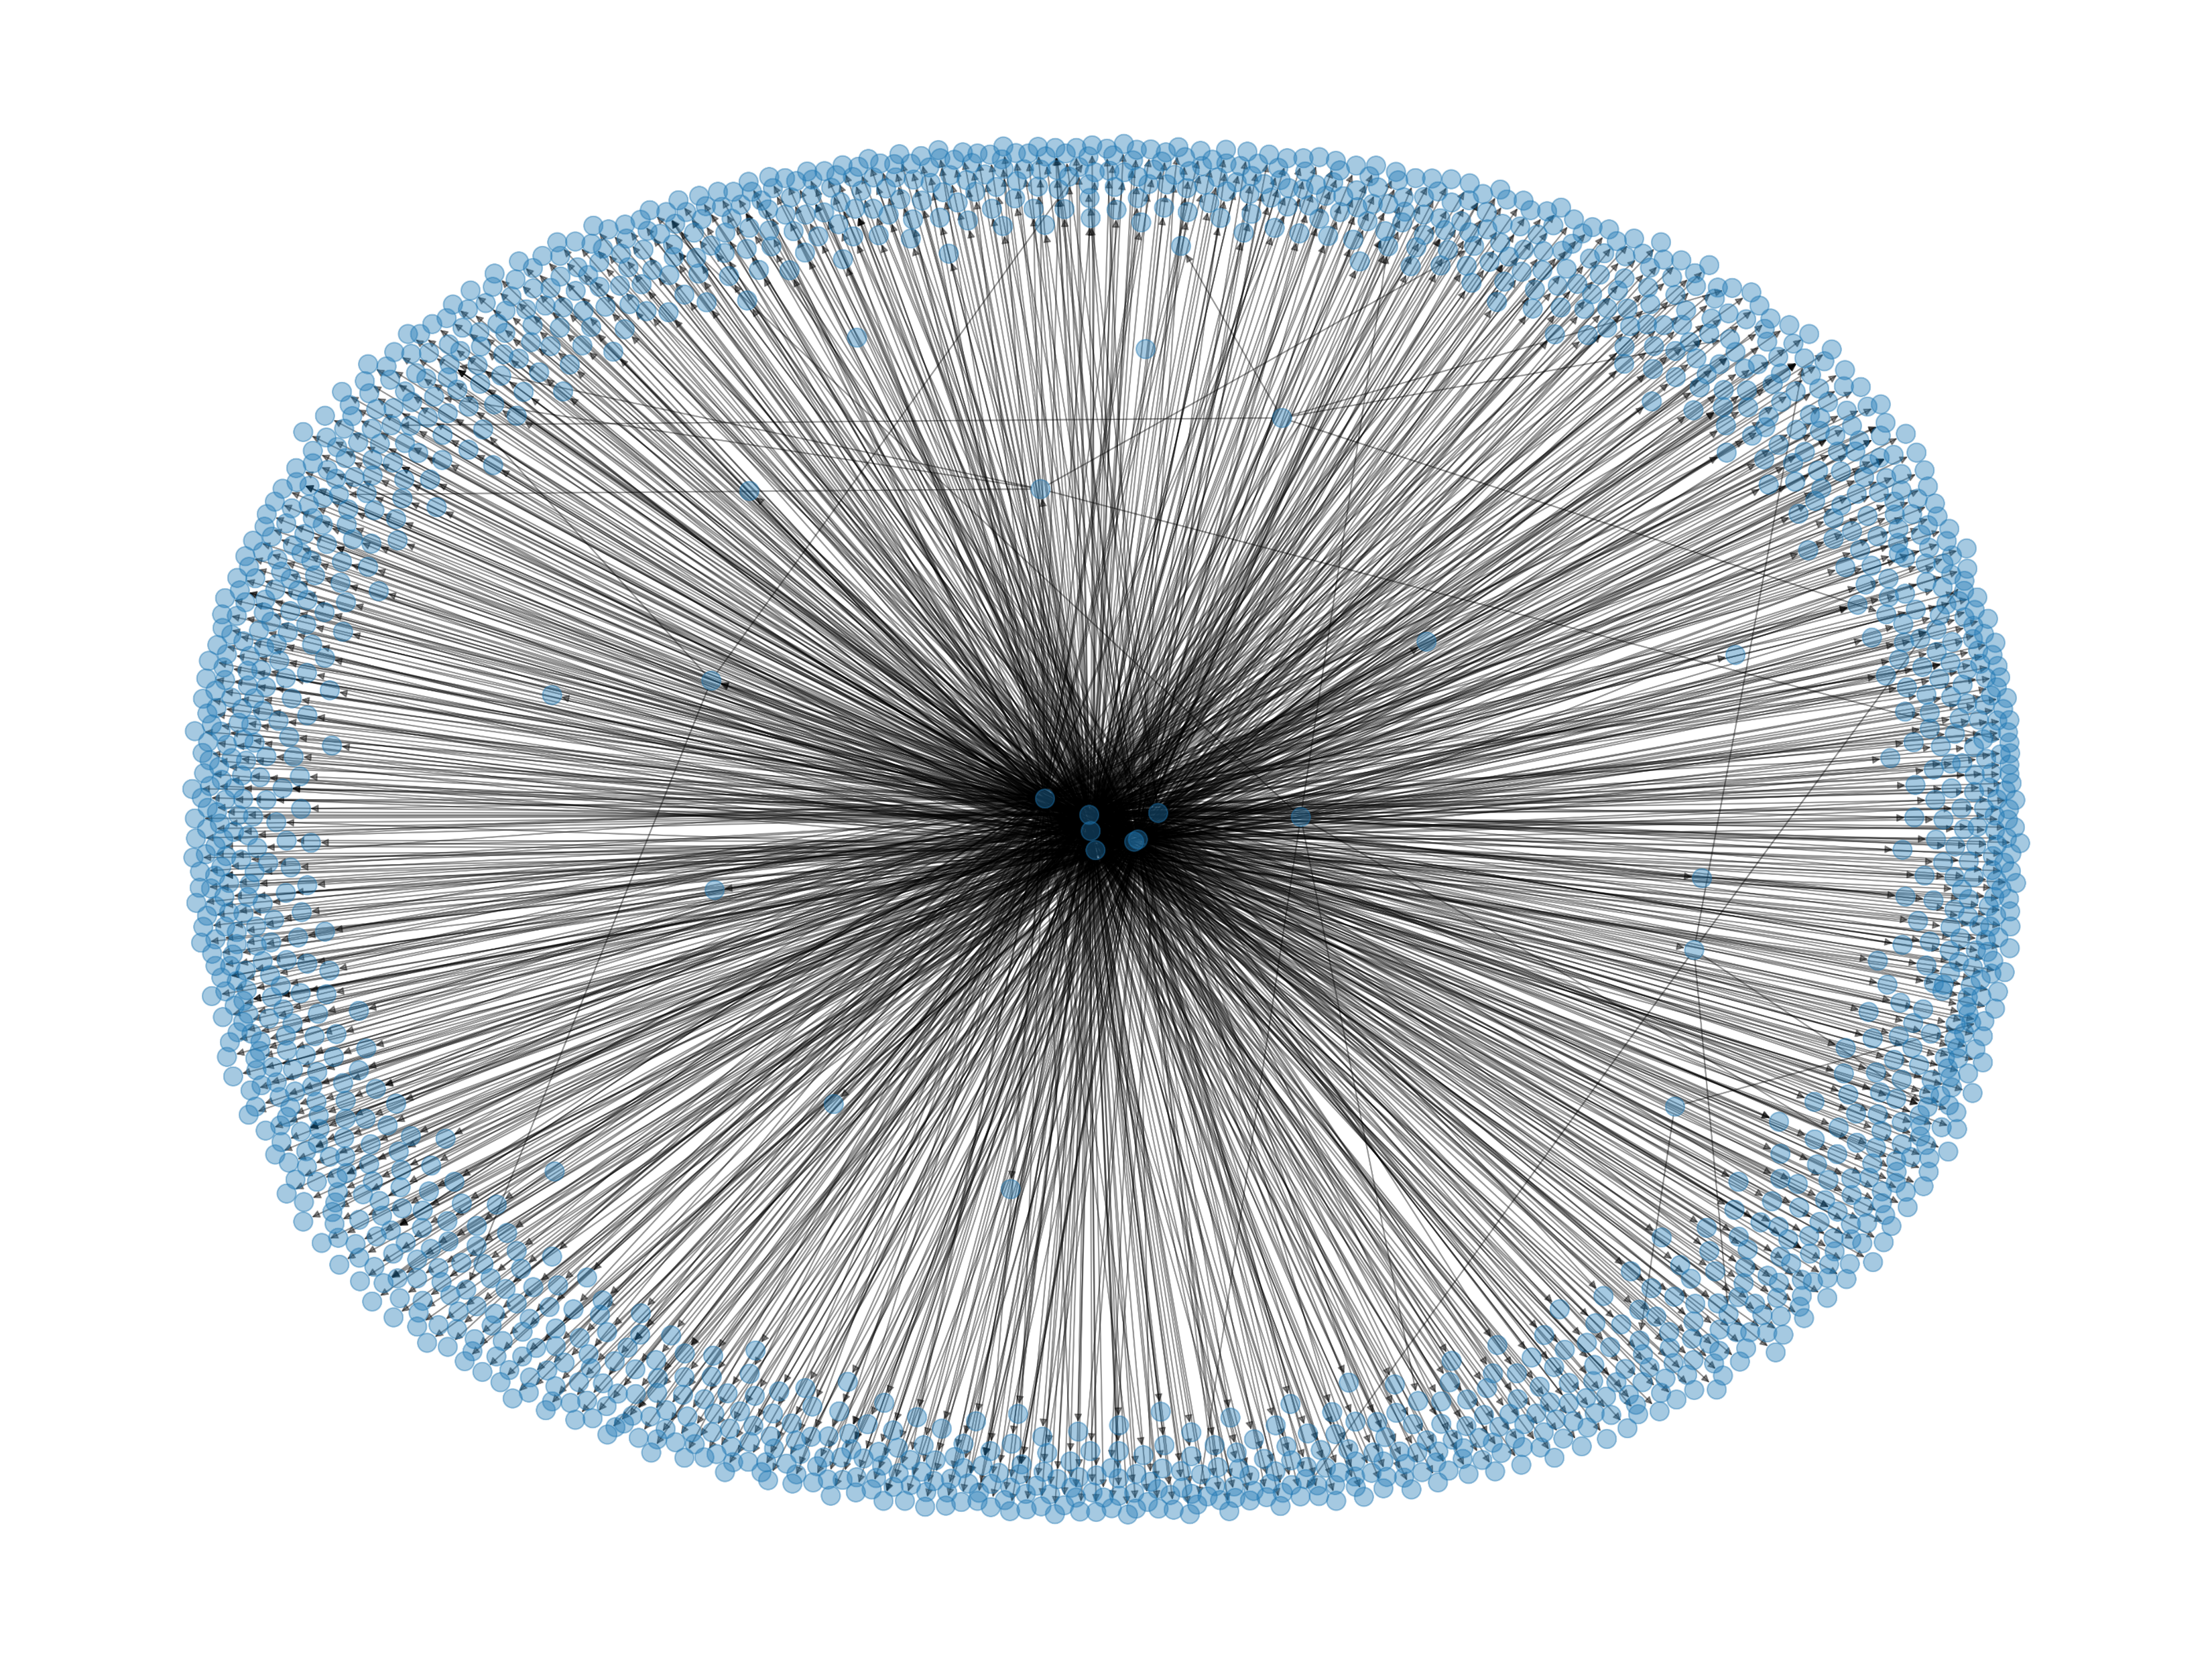

Methodologies & Results – Network Analysis (#gamestop)
Before 1-27
After 1-27
Notes:
We did a network analysis based on the dataset scraped from Twitter,
first column: overall network plots before and after the big jump of stock price happened, which is January 27th, The interesting finding: that the network structure has a big difference.
Before January 27, the network structure has multiple layers, which means that most users have equal effect and relatively same connections for the GameStop topic.
However, after January 27, the network structure becomes more centralized, which means a small part of the users made a major part of the effect.
2. Second column: We can have a more straightforward observation from these two plots in the second column,
We plotted the network with the top 10 influencers.
The colour of the edge indicates the degree centralities value for the pointed nodes
the size of the node also depends on the degree centralities score.
Before 1-27, the nodes' size has no big difference, and the colour of the edge is varied.
After 1-27, the nodes' size has a considerable difference, and the colour of the edge is more consistent.
3. After we checked the user accounts, we can see that before January 27, the users who are a big fan of video games are top influencers, just like the screenshot shown here, but after January 27, the topic game stop has drawn more official accounts’ attention, such as Forbes.

Slide 5

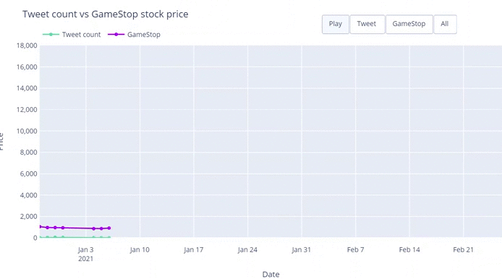
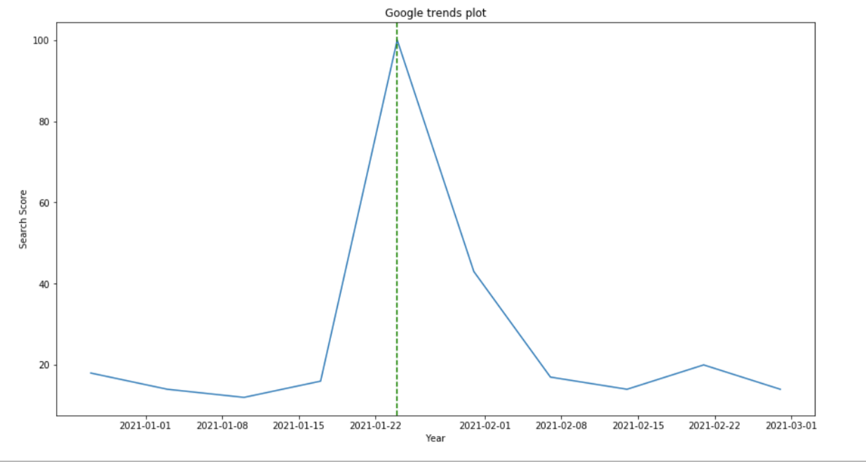
Tweet count VS Stock Price
Surprisingly found that the highest search index happened on Jan 24th
Tweet count across two months with stock price
Google Search Index across two months
Notes:
To understand the relationship between the tweet count and game stop’s stock price, we plotted the graph showing that the tweet count has a pretty similar pattern with the stock price, and the peak point has happened just one day after the stock price peak point. Compare the social media platform’s reaction time with search engines. We have a surprising finding that the google search index's peak point is three days before the stock’s peak point. So we can see that the tweet’s pattern is closer to the stock’s pattern, but the google search index is a good signal for stock buyers in this specific case. (I wish I can know that before January 27th lolllll)

Slide 6

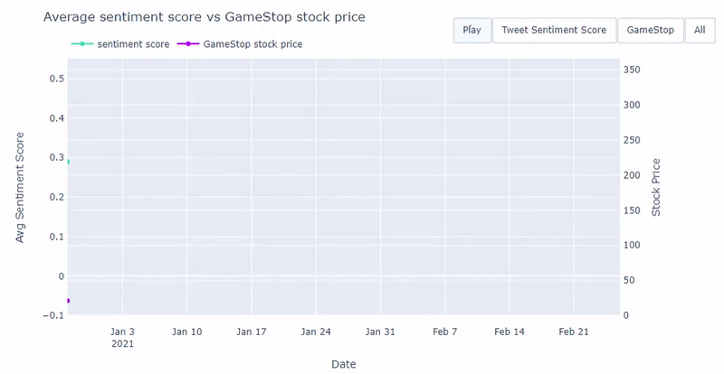
Methodologies & Results – Sentiment Analysis
Positive before the rise
Sentiment dropped down to neutral when the stock price increased
Sentiment keep dropping to negative right after the fluctuation

Slide 7
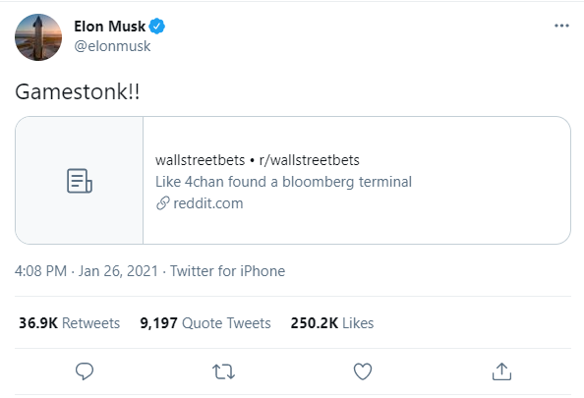
Methodologies & Results – Topic Modelling
Rank | Overall Topics for the period (2020-12-27 – 2021-02-26)
1 | gme
2 | amc
3 | wallstreetbets
4 | gamestonk
5 | robinhood
Topic words | Date
shop | 2020-12-27
shop | 2020-12-28
shop | 2020-12-29
… | …
gamestop | 2021-02-26
Rank | Groups of topics word every date | Count of topic word
1 | gamestop | 35
2 | gme | 14
3 | shop | 9
4 | gt | 3
5 | Ps | 1
Before 1-27
After 1-27
Groups of topics word | Count of topic word
gamestop | 15
shop | 9
gme | 3
gt | 3
ps | 1
Groups of topics word | Count of topic word
gamestop | 20
gme | 11

Slide 8

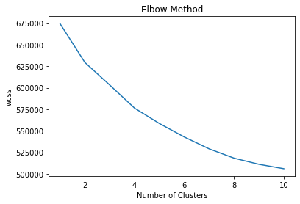
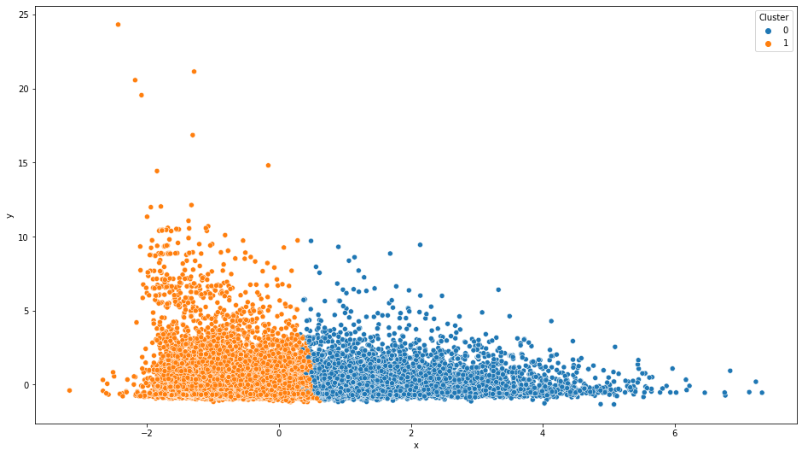
Methodologies & Results – Clustering
K-means clustering to create clusters based on similarity of tweets.
Elbow method to determine optimal number of clusters.
Optimal number of clusters is two.
Notes:
K-means clustering to create clusters based on similarity of tweets.
Optimal number for this data-set was between 2 and 4
As you can see in figure above
After testing in that range, we decided two cluster was optimal
The results of the K-means model is the figure below
Since there are two clusters then the tweets can be classified in to two groups of opposite sentiments as in positive and negative sentiments

Slide 9
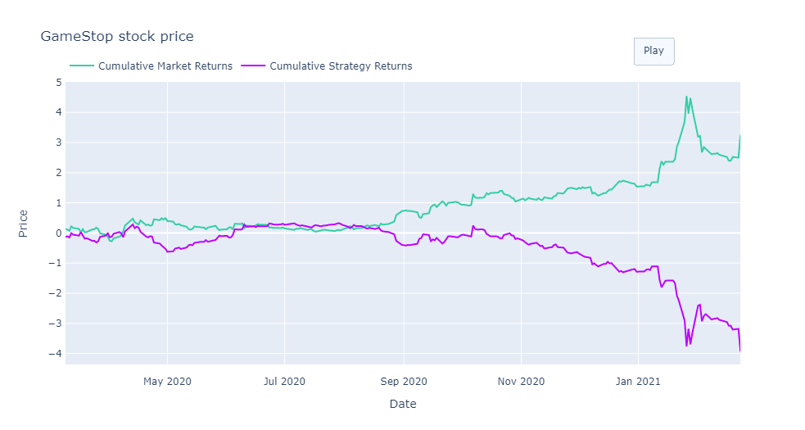
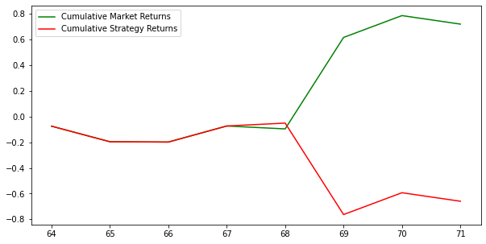
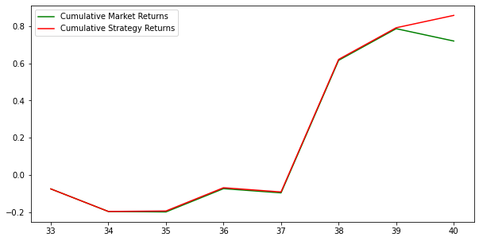
Methodologies & Results – Stock Prediction
Using Stock Data Only (5 years)
Using Stock Data Only (2 months)
Using Stock, Sentiment, and Network Data (2 months)
Initial Columns used: Volume, Adj Close, High minus Low price, Close minus Open price, Three day moving average, Ten day moving average, 30 day moving average, Standard deviation, RSI, Williams %R
Added Columns: degree, betweenness centrality, followers, sentiment Target: Price rise
Strategy: Buy if y=1, sell if y=0, plot the cumulative return
Limitation: Only have 2 months data scrapped from Twitter, Overfitting
Notes:
The way we have build our prediction model:
Predictor columns (X):
Volume: trading volume
Adj Close: stock's closing price after accounting for any corporate actions
High minus Low price: High - Low
Close minus Open price: Close - Open
Three day moving average: mean 3 days closing price
Ten day moving average: mean 10 days closing price
30 day moving average: mean 30 days closing price
Standard deviation: for a period of 5 days based on closing price
Relative Strength Index (RSI): chart the current and historical strength/weakness of a stock/market based on the closing prices of the most recent trading period.
Williams %R: technical analysis oscillator showing the current closing price in relation to the high and low of the past 7 days.
Target variable (y):
Price rise: binary (0 or 1): 1 if closing price of tomorrow is greater than the todays’ closing price
Strategy:
Build our sequential classifier
Predict the price rise
Take a long position if the predicted value of y is 1 and take a short position if the predicted price is 0
Compute the returns that the strategy will make at the end of the day
Then plot the cumulative return
From the first graph, using stock data from Yahoo on 5 years time frame, we can see that there is a big difference especially towards end of jan. we can see that the performance of our model with only using the stock data is not enough
Similar test has been performed using 2 months stock data, we can obs similar results with a big difference in term of the cumulative market return and the strategy return. Decide to include other factors.
Then we added to the predicted columns the average degree centrality, betweenness centrality, followers counted, sentiment score by date using the data scrapped from twitter computed in our previous step.
Overfitting: build the model and fit the result
3:20min

Slide 10


Insights/recommendations
Insights:
It is evident that social media platforms can influence the stock market.
Predicting stock prices allows companies to make appropriate decisions in anticipation of market fluctuation.
The sentiment analysis on Tweets illustrated that many users had skeptical opinions when GME stock price rocketed as well as a balance between positive and negative.
Recommendations:
Investors need to take into account events occurring on social media when making decisions related to the stock market.
It is important for companies to have a positive image on social media because tweets with negative sentiment can lead to stock price drop.
Using sentiment and network information together with the stock price data can improve stock price prediction’s accuracy and lead to higher returns.
The node relationship and the volume of related tweets can have a significant impact on stock price in the case of the GME stock
Important social media influencers can also play an important role in the stock market
Notes:
Can we predict the stock price using sentiment?
Insight regarding top influential accounts or network analysis in general

Slide 11

Appendix

Slide 12
More on GameStop Story
On January 22, 2021, users of r/wallstreetbets initiated a short squeeze on GameStop, pushing their stock prices up significantly
After a comment from Citron Research predicting the value of the stock would decrease
The stock price jump up significantly by more than 600% by the end of January

Slide 13
Methodologies Used – Stock Prediction
Predictor columns (X):
Volume: trading volume
Adj Close: stock's closing price after accounting for any corporate actions
High minus Low price: High - Low
Close minus Open price: Close - Open
Three day moving average: mean 3 days closing price
Ten day moving average: mean 10 days closing price
30 day moving average: mean 30 days closing price
Standard deviation: for a period of 5 days based on closing price
Relative Strength Index (RSI): chart the current and historical strength/weakness of a stock/market based on the closing prices of the most recent trading period.
Williams %R: technical analysis oscillator showing the current closing price in relation to the high and low of the past 7 days.
Target variable (y):
Price rise: binary (0 or 1): 1 if closing price of tomorrow is greater than the todays’ closing price
Added Predictor columns (X):
Degree centrality
Betweenness centrality
Follower counts
Sentiment
Strategy:
Build our sequential classifier
Predict the price rise
Take a long position if the predicted value of y is 1 and take a short position if the predicted price is 0
Compute the returns that the strategy will make at the end of the day

